Slide 1

2025
PRC Community
Health Needs Assessment
Staunton, Waynesboro & August County, Virginia
Notes:
So this is one of my favorite Community Partnership meetings, when we are able to present the data uncovered in our triannual needs assessment. I know some of you were able many people to attend the “Big Reveal” session on August 11 at the Blackburn when Bruce with PRC presented this data? So some of this will be bit of a repeat for some of you but will review some new information too, and I’m be adding in not only some more local flair but also next steps.
PSA of SAW surveyed

Slide 2


Community Health Needs Assessment
The PRC Community Health Needs Assessment consists of both primary and secondary data.
BENCHMARKING
Previous Survey Data (2016, 2019, 2022)
PRC National Health Survey
VA BRFSS data
Healthy People 2030 targets
National vital statistics data
Secondary Data
  County-level data
  Census data, vital statistics, other health-related data
Online Key Informant Survey
  Community stakeholder input — 124 physicians, public health, other health providers, social services, community leaders
  Based on their experiences, the populations they serve
Customized Local Health Survey
  Population-based, stratified by hospital service area
  Targets health status, experience, behaviors
  Conducted via landline/cell phones and internet-based surveys

Slide 3
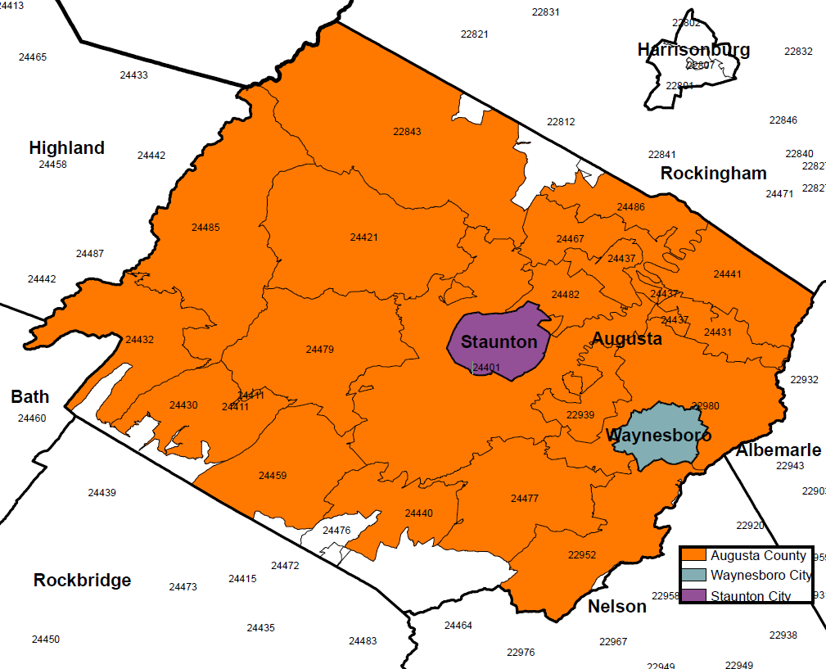
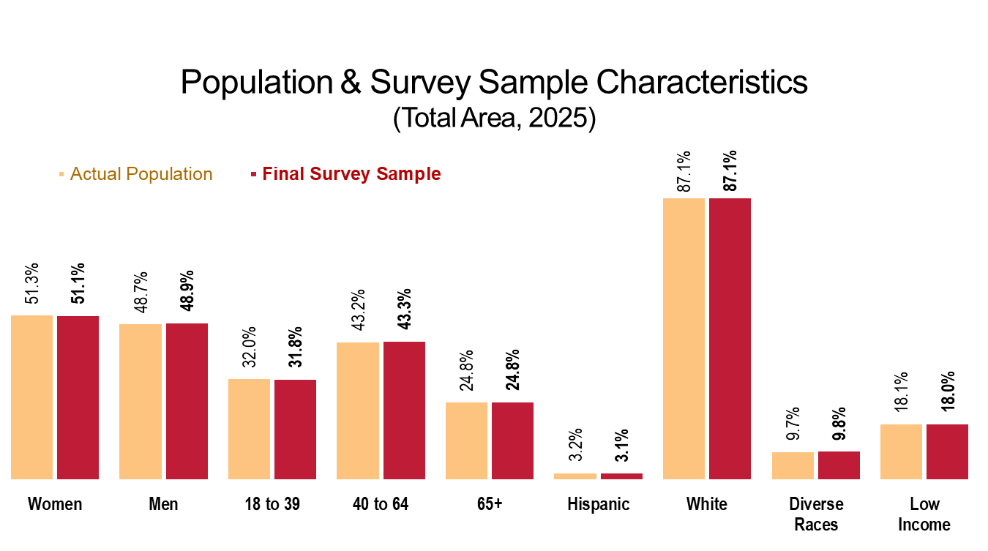
Population Survey
860 surveys stratified across the service area:
  227 in Staunton City
  177 in Waynesboro City
  456 in Augusta County
Final sample weighted in
proportion to total population
Over 100 survey items;
20-25 minute interview.
Total sample size gives an overall maximum confidence interval of ±3.4%.

Slide 4
Community Description
The total survey are encompasses 1,000 square miles and 126,000 residents.
Staunton, Waynesboro, and Augusta County are slightly ‘older’ than the state and the nation in that their median agers are higher.
84% of residents are white and 7% are black.
The Hispanic population increased by 2,400 between the 2010 and 2020 census counts, and is now 5% of the total area population.
11,109 total area residents live in poverty; 30% of which are children (Note: Very low income is defined as 100% of below of the FPL)

Slide 5
Priority Needs

Slide 6
General Health Status
Areas of Opportunity
  Access to Health Care Services
  Cancer
  Diabetes
  Disabling Conditions
  Heart Disease & Stroke
  Housing
  Infant Health & Family Planning
  Injury & Violence
  Mental Health
  Nutrition, Physical Activity & Weight
  Respiratory Disease
  Substance Use
  Tobacco Use
Q & A

Slide 7
Self-Reported Health Status
(Total Area, 2025)
Sources: ● 2025 PRC Community Health Survey, PRC, Inc. [Item 4]
Notes: ● Asked of all respondents.

Slide 8
Experience “Fair” or “Poor” Overall Health
Total Area
Similar among communities
Similar to VA & US
No significant change
Sources: ● 2025 PRC Community Health Survey, PRC, Inc. [Item 4]
● Behavioral Risk Factor Surveillance System Survey Data. Atlanta, Georgia. United States Department of Health and Human Services, Centers for Disease Control and Prevention (CDC): 2023 VA data.
● 2023 PRC National Health Survey, PRC, Inc.
Notes: ● Asked of all respondents.

Slide 9
Experience “Fair” or “Poor” Overall Health
(Total Area, 2025)
Sources: ● 2025 PRC Community Health Survey, PRC, Inc. [Item 4]
Notes: ● Asked of all respondents.

Slide 10
General Health Status
Areas of Opportunity
  Access to Health Care Services
  Cancer
  Diabetes
  Disabling Conditions
  Heart Disease & Stroke
  Housing
  Infant Health & Family Planning
  Injury & Violence
  Mental Health
  Nutrition, Physical Activity & Weight
  Respiratory Disease
  Substance Use
  Tobacco Use
Q & A

Slide 11
Health Care Insurance Coverage
(Adults 18-64; Total Area, 2025)
(Similar to VA & US)
Sources: ● 2025 PRC Community Health Survey, PRC, Inc. [Item 117]
Notes: ● Reflects respondents age 18 to 64.

Slide 12
Barriers to Access Have
Prevented Medical Care in the Past Year
Sources: ● 2025 PRC Community Health Survey, PRC, Inc. [Items 6-13]
● 2023 PRC National Health Survey, PRC, Inc.
Notes: ● Asked of all respondents.
Each of these has increased significantly in the Total Area since 2016.

Slide 13
Experienced Difficulties or Delays of Some Kind in Receiving Needed Health Care in the Past Year
Total Area
Sources: ● 2025 PRC Community Health Survey, PRC, Inc. [Item 119]
● 2023 PRC National Health Survey, PRC, Inc.
Notes: ● Asked of all respondents.
● Percentage represents the proportion of respondents experiencing one or more barriers to accessing health care in the past 12 months.

Slide 14
Experienced Difficulties or Delays of Some Kind in Receiving Needed Health Care in the Past Year
(Total Area, 2025)
Sources: ● 2025 PRC Community Health Survey, PRC, Inc. [Item 119]
Notes: ● Asked of all respondents.
● Percentage represents the proportion of respondents experiencing one or more barriers to accessing health care in the past 12 months.

Slide 15
Have Visited a Physician for a Checkup in the Past Year
Total Area
Sources: ● 2025 PRC Community Health Survey, PRC, Inc. [Item 16]
● Behavioral Risk Factor Surveillance System Survey Data. Atlanta, Georgia. United States Department of Health and Human Services, Centers for Disease Control and Prevention (CDC): 2023 VA data.
● 2023 PRC National Health Survey, PRC, Inc.
Notes: ● Asked of all respondents.
There are 120 primary care
physicians in the Total Area, for a
rate of 95.7 per 100,000
(lower than state and national ratios).

Slide 16
Have Used a Hospital
Emergency Room More Than Once in the Past Year
Total Area
Sources: ● 2025 PRC Community Health Survey, PRC, Inc. [Item 19]
● 2023 PRC National Health Survey, PRC, Inc.
Notes: ● Asked of all respondents.

Slide 17
General Health Status
Areas of Opportunity
  Access to Health Care Services
  Cancer
  Diabetes
  Disabling Conditions
  Heart Disease & Stroke
  Housing
  Infant Health & Family Planning
  Injury & Violence
  Mental Health
  Nutrition, Physical Activity & Weight
  Respiratory Disease
  Substance Use
  Tobacco Use
Q & A

Slide 18
Leading Causes of Death
(Total Area, 2023)
Sources: ● CDC WONDER Online Query System. Centers for Disease Control and Prevention, Epidemiology Program Office, Division of Public Health Surveillance and Informatics. Data extracted April 2025.
Notes: ● Lung disease includes deaths classified as chronic lower respiratory disease.

Slide 19
Cancer Mortality
(2021-2023 Annual Average Deaths per 100,000 Population)
Healthy People 2030 = 122.7 or Lower
Sources: ● CDC WONDER Online Query System. Centers for Disease Control and Prevention, Epidemiology Program Office, Division of Public Health Surveillance and Informatics. Data extracted April 2025.
● US Department of Health and Human Services. Healthy People 2030. https://health.gov/healthypeople
Notes: ● Deaths are coded using the Tenth Revision of the International Statistical Classification of Diseases and Related Health Problems (ICD-10).
● Rates are per 100,000 population.
Also, relatively high mortality for:
Lung cancer
Female breast cancer
Colorectal cancer

Slide 20
Prevalence of Cancer
Total Area
The most common types of cancers cited locally include:
Melanoma 23.4%
Breast Cancer 19.5%
Prostate Cancer 10.9%
Sources: ● 2025 PRC Community Health Survey, PRC, Inc. [Items 24-25]
● Behavioral Risk Factor Surveillance System Survey Data. Atlanta, Georgia. United States Department of Health and Human Services, Centers for Disease Control and Prevention (CDC): 2023 VA data.
● 2023 PRC National Health Survey, PRC, Inc.
Notes: ● Asked of all respondents.
Cancer history increases to 28.5% of those age 65+

Slide 21
Breast Cancer Screening
(Women 50-74)
Healthy People 2030 = 80.5% or Higher
Cervical Cancer Screening
(Women 21-65)
Healthy People 2030 = 84.3% or Higher
Colorectal Cancer Screening
(All Adults 45-75)
Healthy People 2030 = 74.4% or Higher
Sources: ● 2025 PRC Community Health Survey, PRC, Inc. [Items 101-103]
● Behavioral Risk Factor Surveillance System Survey Data. Atlanta, Georgia. United States Department of Health and Human Services, Centers for Disease Control and Prevention (CDC): 2023 VA data.
● 2023 PRC National Health Survey, PRC, Inc.
● US Department of Health and Human Services. Healthy People 2030. https://health.gov/healthypeople
Notes: ● Each indicator is shown among the gender and/or age group specified.
● Note that national data for colorectal cancer screening reflect adults ages 50 to 75.

Slide 22
General Health Status
Areas of Opportunity
  Access to Health Care Services
  Cancer
  Diabetes
  Disabling Conditions
  Heart Disease & Stroke
  Housing
  Infant Health & Family Planning
  Injury & Violence
  Mental Health
  Nutrition, Physical Activity & Weight
  Respiratory Disease
  Substance Use
  Tobacco Use
Q & A

Slide 23
Diabetes Mortality
(2021-2023 Annual Average Deaths per 100,000 Population)
Sources: ● CDC WONDER Online Query System. Centers for Disease Control and Prevention, Epidemiology Program Office, Division of Public Health Surveillance and Informatics. Data extracted April 2025.
Notes: ● Deaths are coded using the Tenth Revision of the International Statistical Classification of Diseases and Related Health Problems (ICD-10).
● Rates are per 100,000 population.
Consistently higher than VA and US throughout the past decade.
Kidney disease deaths are likewise high.

Slide 24
Prevalence of Diabetes
Another 16.4% of adults have been diagnosed with “pre-diabetes” or “borderline” diabetes (vs. 5.7% US).
Total Area
Sources: ● 2025 PRC Community Health Survey, PRC, Inc. [Item 106]
● Behavioral Risk Factor Surveillance System Survey Data. Atlanta, Georgia. United States Department of Health and Human Services, Centers for Disease Control and Prevention (CDC): 2023 VA data.
● 2023 PRC National Health Survey, PRC, Inc.
Notes: ● Asked of all respondents. Excludes gestational diabetes (occurring only during pregnancy).

Slide 25
Prevalence of Diabetes
(Total Area, 2025)
Sources: ● 2025 PRC Community Health Survey, PRC, Inc. [Item 106]
Notes: ● Asked of all respondents.
● Excludes gestational diabetes (occurring only during pregnancy).

Slide 26
General Health Status
Areas of Opportunity
  Access to Health Care Services
  Cancer
  Diabetes
  Disabling Conditions
  Heart Disease & Stroke
  Housing
  Infant Health & Family Planning
  Injury & Violence
  Mental Health
  Nutrition, Physical Activity & Weight
  Respiratory Disease
  Substance Use
  Tobacco Use
Q & A

Slide 27
Limited in Activities in Some Way
Due to a Physical, Mental, or Emotional Problem
Most common conditions:
Mental health
Back/neck problems
Arthritis
Difficulty walking
Bone/joint injury
Total Area
Sources: ● 2025 PRC Community Health Survey, PRC, Inc. [Items 83-84]
● 2023 PRC National Health Survey, PRC, Inc.
Notes: ● Asked of all respondents.

Slide 28
Limited in Activities in Some Way
Due to a Physical, Mental, or Emotional Problem
(Total Area, 2025)
Sources: ● 2025 PRC Community Health Survey, PRC, Inc. [Item 83]
Notes: ● Asked of all respondents.

Slide 29
Family Member Has Been Diagnosed with Alzheimer’s Disease
Total Area
Sources: ● 2025 PRC Community Health Survey, PRC, Inc. [Item 308]
Notes: ● Asked of all respondents.
Notes:
Alzhimer’s Disease deaths are notably higher than both VA and US rates

Slide 30
Act as Caregiver to a Friend or Relative with a Health Problem, Long-Term Illness, or Disability
The top health issues affecting those receiving their care include:
Old age/frailty
Dementia/cognitive
Heart disease
Cancer
Mental illness
Total Area
Sources: ● 2025 PRC Community Health Survey, PRC, Inc. [Items 85-86]
● 2023 PRC National Health Survey, PRC, Inc.
Notes: ● Asked of all respondents.

Slide 31
General Health Status
Areas of Opportunity
  Access to Health Care Services
  Cancer
  Diabetes
  Disabling Conditions
  Heart Disease & Stroke
  Housing
  Infant Health & Family Planning
  Injury & Violence
  Mental Health
  Nutrition, Physical Activity & Weight
  Respiratory Disease
  Substance Use
  Tobacco Use
Q & A

Slide 32
Leading Causes of Death
(Total Area, 2023)
Sources: ● CDC WONDER Online Query System. Centers for Disease Control and Prevention, Epidemiology Program Office, Division of Public Health Surveillance and Informatics. Data extracted April 2025.
Notes: ● Lung disease includes deaths classified as chronic lower respiratory disease.

Slide 33
Heart Disease Mortality
(2021-2023 Annual Average Deaths per 100,000)
Healthy People 2030 = 127.4 or Lower (Adjusted)
Stroke Mortality
(2021-2023 Annual Average Deaths per 100,000)
Healthy People 2030 = 33.4 or Lower
Sources: ● CDC WONDER Online Query System. Centers for Disease Control and Prevention, Epidemiology Program Office, Division of Public Health Surveillance and Informatics. Data extracted April 2025.
● US Department of Health and Human Services. Healthy People 2030. https://health.gov/healthypeople
Notes: ● The Healthy People 2030 coronary heart disease target is adjusted here to account for all diseases of the heart.
● Deaths are coded using the Tenth Revision of the International Statistical Classification of Diseases and Related Health Problems (ICD-10).
● Rates are per 100,000 population.

Slide 34
Prevalence of
High Blood Pressure
Healthy People 2030 = 42.6% or Lower
Prevalence of
High Blood Cholesterol
Sources: ● 2025 PRC Community Health Survey, PRC, Inc. [Items 29-30]
● Behavioral Risk Factor Surveillance System Survey Data. Atlanta, Georgia. United States Department of Health and Human Services, Centers for Disease Control and Prevention (CDC): 2023 VA data.
● 2023 PRC National Health Survey, PRC, Inc.
● US Department of Health and Human Services. Healthy People 2030. https://health.gov/healthypeople
Notes: ● Asked of all respondents.
A growing percentage of residents (89.4%) exhibit one or more cardiovascular risk factors (high blood pressure, high cholesterol, overweight, not enough exercise, smoking).

Slide 35
General Health Status
Areas of Opportunity
  Access to Health Care Services
  Cancer
  Diabetes
  Disabling Conditions
  Heart Disease & Stroke
  Housing
  Infant Health & Family Planning
  Injury & Violence
  Mental Health
  Nutrition, Physical Activity & Weight
  Respiratory Disease
  Substance Use
  Tobacco Use
Q & A

Slide 36
Housing Trends
(Total Area)
“Always/Usually/Sometimes” Worried About Paying Rent/Mortgage in Past Yr
Had to Live With a Friend/Relative in the Past
2 Yrs Due to an Emergency (Even if Temporary)
Homeless At Some Point
in the Past 2 Yrs
Sources: ● 2025 PRC Community Health Survey, PRC, Inc.
● 2023 PRC National Health Survey, PRC, Inc.
Notes: ● Asked of all respondents.
Notes:
We usually think of in the SDOH bucket but rose to the top as its own health priority this time.

Slide 37
“Always/Usually/Sometimes” Worried
About Paying Rent/Mortgage in the Past Year
(Total Area, 2025)
Among homeowners 19.5%
Among renters 49.3%
Sources: ● 2025 PRC Community Health Survey, PRC, Inc. [Item 56]
Notes: ● Asked of all respondents.

Slide 38
Unhealthy or Unsafe Housing Conditions in the Past Year
Total Area
Sources: ● 2025 PRC Community Health Survey, PRC, Inc. [Item 55]
● 2023 PRC National Health Survey, PRC, Inc.
Notes: ● Asked of all respondents.
● Includes respondents who say they experienced ongoing problems in their current home with water leaks, rodents, insects, mold, or other housing conditions that might make living there unhealthy or unsafe.

Slide 39
General Health Status
Areas of Opportunity
  Access to Health Care Services
  Cancer
  Diabetes
  Disabling Conditions
  Heart Disease & Stroke
  Housing
  Infant Health & Family Planning
  Injury & Violence
  Mental Health
  Nutrition, Physical Activity & Weight
  Respiratory Disease
  Substance Use
  Tobacco Use
Q & A
Notes:
Just one slide to share

Slide 40
Infant Mortality Trends
(Annual Average Infant Deaths per 1,000 Live Births)
Healthy People 2030 = 5.0 or Lower
Sources: ● CDC WONDER Online Query System. Centers for Disease Control and Prevention, National Center for Health Statistics, Division of Vital Statistics.
Data extracted April 2025.
● Centers for Disease Control and Prevention, National Center for Health Statistics.
● US Department of Health and Human Services. Healthy People 2030. https://health.gov/healthypeople
Notes: ● Rates are three-year averages of deaths of children under 1 year old per 1,000 live births.
Notes:
Family Planning – higher incidence of adolescent mothers than found nationwide

Slide 41
General Health Status
Areas of Opportunity
  Access to Health Care Services
  Cancer
  Diabetes
  Disabling Conditions
  Heart Disease & Stroke
  Housing
  Infant Health & Family Planning
  Injury & Violence
  Mental Health
  Nutrition, Physical Activity & Weight
  Respiratory Disease
  Substance Use
  Tobacco Use
Q & A

Slide 42
Unintentional Injury Mortality Trends
(Annual Average Deaths per 100,000 Population)
Healthy People 2030 = 43.2 or Lower
Leading Causes of
Unintentional Injury Deaths
(Total Area, 2021-2023)
Sources: ● CDC WONDER Online Query System. Centers for Disease Control and Prevention, Epidemiology Program Office, Division of Public Health Surveillance and Informatics. Data extracted April 2025.
● US Department of Health and Human Services. Healthy People 2030. https://health.gov/healthypeople
Notes: ● Deaths are coded using the Tenth Revision of the International Statistical Classification of Diseases and Related Health Problems (ICD-10).
● Rates are per 100,000 population.

Slide 43
Victim of a Violent Crime in the Past Five Years
Total Area
Sources: ● 2025 PRC Community Health Survey, PRC, Inc. [Item 32]
● 2023 PRC National Health Survey, PRC, Inc.
Notes: ● Asked of all respondents.
More prevalent among young adults and those with lower incomes.

Slide 44
Have Ever Been Hit, Slapped, Pushed,
Kicked, or Hurt in Any Way by an Intimate Partner
Total Area
Sources: ● 2025 PRC Community Health Survey, PRC, Inc. [Item 33]
● 2023 PRC National Health Survey, PRC, Inc.
Notes: ● Asked of all respondents.

Slide 45
General Health Status
Areas of Opportunity
  Access to Health Care Services
  Cancer
  Diabetes
  Disabling Conditions
  Heart Disease & Stroke
  Housing
  Infant Health & Family Planning
  Injury & Violence
  Mental Health
  Nutrition, Physical Activity & Weight
  Respiratory Disease
  Substance Use
  Tobacco Use
Q & A

Slide 46
Mental Health
(Total Area)
Experience “Fair” or “Poor” Mental Health
Have Been Diagnosed With a Depressive Disorder
Perceive Most Days As “Extremely” or “Very” Stressful
Sources: ● 2025 PRC Community Health Survey, PRC, Inc.
● 2023 PRC National Health Survey, PRC, Inc.
Notes: ● Asked of all respondents.
Each of these is significantly higher in Staunton than elsewhere in the area.

Slide 47
Have Experienced Symptoms of Chronic Depression
(Total Area, 2025)
Sources: ● 2025 PRC Community Health Survey, PRC, Inc. [Item 78]
Notes: ● Asked of all respondents.
● Chronic depression includes periods of two or more years during which the respondent felt depressed or sad on most days, even if (s)he felt okay sometimes.

Slide 48
Suicide Mortality Trends
(Annual Average Deaths per 100,000 Population)
Healthy People 2030 = 12.8 or Lower
Sources: ● CDC WONDER Online Query System. Centers for Disease Control and Prevention, Epidemiology Program Office, Division of Public Health Surveillance and Informatics. Data extracted April 2025.
● US Department of Health and Human Services. Healthy People 2030. https://health.gov/healthypeople
Notes: ● Deaths are coded using the Tenth Revision of the International Statistical Classification of Diseases and Related Health Problems (ICD-10).
● Rates are per 100,000 population.

Slide 49
Unable to Get Mental Health Services When Needed in the Past Year
Total Area
Sources: ● 2025 PRC Community Health Survey, PRC, Inc. [Item 82]
● 2023 PRC National Health Survey, PRC, Inc.
Notes: ● Asked of all respondents.
Higher among young adults, those with lower incomes, and LGBTQ+ residents.

Slide 50
General Health Status
Areas of Opportunity
  Access to Health Care Services
  Cancer
  Diabetes
  Disabling Conditions
  Heart Disease & Stroke
  Housing
  Infant Health & Family Planning
  Injury & Violence
  Mental Health
  Nutrition, Physical Activity & Weight
  Respiratory Disease
  Substance Use
  Tobacco Use
Q & A
Notes:
Percentage of those getting five or more servings of fruits or veggies per day has significantly decreased since 2016

Slide 51
Prevalence of Total Overweight (Overweight and Obese)
Total Area
Sources: ● 2025 PRC Community Health Survey, PRC, Inc. [Item 112]
● Behavioral Risk Factor Surveillance System Survey Data. Atlanta, Georgia. United States Department of Health and Human Services, Centers for Disease Control and Prevention (CDC): 2023 VA data.
● 2023 PRC National Health Survey, PRC, Inc.
Notes: ● Based on reported heights and weights, asked of all respondents.
● The definition of overweight is having a body mass index (BMI), a ratio of weight to height (kilograms divided by meters squared), greater than or equal to 25.0,.
The definition for obesity is a BMI greater than or equal to 30.0.
This includes 41.0% of Total Area adults who are obese.

Slide 52
Food Insecurity
(Total Area)
Well below the US (43.3%)
Sources: ● 2025 PRC Community Health Survey, PRC, Inc. [Item 98]
● 2023 PRC National Health Survey, PRC, Inc.
Notes: ● Asked of all respondents.
● Includes adults who A) ran out of food at least once in the past year and/or B) worried about running out of food in the past year.

Slide 53
Meets Physical Activity Recommendations
Healthy People 2030 = 29.7% or Higher
Total Area
Sources: ● 2025 PRC Community Health Survey, PRC, Inc. [Item 110]
● Behavioral Risk Factor Surveillance System Survey Data. Atlanta, Georgia. United States Department of Health and Human Services, Centers for Disease Control and Prevention (CDC): 2023 VA data.
● 2023 PRC National Health Survey, PRC, Inc.
● US Department of Health and Human Services. Healthy People 2030. https://health.gov/healthypeople
Notes: ● Asked of all respondents.
● Meeting both guidelines is defined as the number of persons age 18+ who report light or moderate aerobic activity for at least 150 minutes per week or who report vigorous physical activity 75 minutes per week (or an equivalent combination of moderate and vigorous-intensity activity) and who also report doing physical activities specifically designed to strengthen muscles at least twice per week.
For children, the percentage getting enough physical activity is better than found nationally, but has worsened over time.

Slide 54
General Health Status
Areas of Opportunity
  Access to Health Care Services
  Cancer
  Diabetes
  Disabling Conditions
  Heart Disease & Stroke
  Housing
  Infant Health & Family Planning
  Injury & Violence
  Mental Health
  Nutrition, Physical Activity & Weight
  Respiratory Disease
  Substance Use
  Tobacco Use
Q & A

Slide 55
Lung Disease Mortality Trends
(Annual Average Deaths per 100,000 Population)
Pneumonia/Influenza Mortality Trends
(Annual Average Deaths per 100,000 Population)
Sources: ● CDC WONDER Online Query System. Centers for Disease Control and Prevention, Epidemiology Program Office, Division of Public Health Surveillance and Informatics. Data extracted April 2025.
Notes: ● Here, lung disease reflects chronic lower respiratory disease (CLRD) deaths and includes conditions such as emphysema, chronic bronchitis, and asthma.
● Deaths are coded using the Tenth Revision of the International Statistical Classification of Diseases and Related Health Problems (ICD-10).
● Rates are per 100,000 population.

Slide 56
Prevalence of Asthma
Total Area
Sources: ● 2025 PRC Community Health Survey, PRC, Inc. [Item 26]
● Behavioral Risk Factor Surveillance System Survey Data. Atlanta, Georgia. United States Department of Health and Human Services, Centers for Disease Control and Prevention (CDC): 2023 VA data.
● 2023 PRC National Health Survey, PRC, Inc.
Notes: ● Asked of all respondents.
Reported more often among women, younger adults, and those with lower incomes.

Slide 57
General Health Status
Areas of Opportunity
  Access to Health Care Services
  Cancer
  Diabetes
  Disabling Conditions
  Heart Disease & Stroke
  Housing
  Infant Health & Family Planning
  Injury & Violence
  Mental Health
  Nutrition, Physical Activity & Weight
  Respiratory Disease
  Substance Use
  Tobacco Use
Q & A

Slide 58
Alcohol-Induced Mortality Trends
(Annual Average Deaths per 100,000 Population)
Survey:
Engage in Excessive Drinking
Better than US, similar to VA
Sources: ● CDC WONDER Online Query System. Centers for Disease Control and Prevention, Epidemiology Program Office, Division of Public Health Surveillance and Informatics. Data extracted April 2025.
Notes: ● Deaths are coded using the Tenth Revision of the International Statistical Classification of Diseases and Related Health Problems (ICD-10).
● Rates are per 100,000 population.
Notes:
Could also include a car accident where alcohol was a factor
Excessive = heavy and/or binge drinking (heavy =2+ drinks per day and binge 5+ drinks on one occasion) for a man

Slide 59
Unintentional Drug-Induced
Mortality Trends
(Annual Average Deaths per 100,000 Population)
Survey:
Illicit Drug Use in the Past Month
Sources: ● CDC WONDER Online Query System. Centers for Disease Control and Prevention, Epidemiology Program Office, Division of Public Health Surveillance and Informatics. Data extracted April 2025.
Notes: ● Deaths are coded using the Tenth Revision of the International Statistical Classification of Diseases and Related Health Problems (ICD-10).
● Rates are per 100,000 population.
Notes:
-Significant increase over time
-underreported
-doesn’t say what is “illicit”
-prescription opiod misuse in our area is decreasing

Slide 60
General Health Status
Areas of Opportunity
  Access to Health Care Services
  Cancer
  Diabetes
  Disabling Conditions
  Heart Disease & Stroke
  Housing
  Infant Health & Family Planning
  Injury & Violence
  Mental Health
  Nutrition, Physical Activity & Weight
  Respiratory Disease
  Substance Use
  Tobacco Use
Q & A

Slide 61
Current Tobacco Use
(Total Area)
Cigarettes
Vaping Products
Smokeless Tobacco
Sources: ● 2025 PRC Community Health Survey, PRC, Inc.
● Behavioral Risk Factor Surveillance System Survey Data. Atlanta, Georgia. United States Department of Health and Human Services, Centers for Disease Control and Prevention (CDC): 2023 VA data.
● 2023 PRC National Health Survey, PRC, Inc.
● US Department of Health and Human Services. Healthy People 2030. https://health.gov/healthypeople
Notes: ● Asked of all respondents.
● Includes those who smoke cigarettes/use vaping products/use smokeless tobacco every day or on some days.
For cigarettes and vaping, local findings are better than found nationally, but worse than found statewide.
Notes:
Vaping – young adults and men are higher

Slide 62
Other Needs

Slide 63
Other Needs
Social Determinants of Health
11,109 total persons in poverty (3,222 children); lower than state and national averages
High percent of Waynesboro residents do not have a HS diploma
Unemployment rate is 2.3%, which lower than national averages
A total of 22% of residents would not be able to afford an unexpected $400 expense without going into debt; lower than the national average
8.5% of total residents do own their vehicle

Slide 64
Other Needs
Sexual Health
HIV prevalence lower than state and national averages; Higer in Staunton and Waynesboro and among Black residents
STI incidence lower than state and national averages; Higher in Waynesboro residents
Family Planning
Higher prevalence of teenage births (ages 15-19) than state and national averages; Higher in Waynesboro and among Hispanic adolescent females
Oral Health
The percent of area residents with dental insurance coverage has increased significantly since 2016
68% of area adults have visited a dentist in the past year; Higher than national averages

Slide 65
Next Steps

Slide 66
Ranked Areas of Opportunity
  Mental Health
  Nutrition, Physical Activity & Weight
  Access to Health Care Services
  Diabetes
  Heart Disease & Stroke
  Housing
  Substance Use
  Cancer
  Infant Health & Family Planning
  Tobacco Use
  Respiratory Disease
  Injury and Violence
Notes:
Key Informants participated in a ranking exercise at the Big Reveal earlier this month, and these is the ranked order

Slide 67
September
Select Priority Needs
October
Begin Implementation Strategy
April
Board Approval of Implementation Strategy
Timeline

Slide 68
Thank You!

